Slide 1
CT004-3.5-3
Advanced Database Systems
Implementing Stored
Procedures

Slide 2
Topic & Structure of Lesson
Implementing Stored Procedures
Creating Parameterized Stored Procedures

Slide 3
Learning Outcomes
By the end of this lesson you should
be able to:
Implement stored procedures.
Create parameterized stored procedures.

Slide 4
What Is a Stored Procedure?
  A stored procedure is a group of Transact-SQL statements compiled into a single execution plan.
Stored Procedures Can:
  Contain statements that perform operations
  Accept input parameters
  Return status value to indicate success or failure
  Return multiple output parameters

Slide 5
Advantages of Using Stored Procedures
Share Application Logic
  All clients can use the same stored procedures to ensure consistent data access and modification.
Shield Database Schema Details
  Users never need to access the tables directly
Provide Security Mechanisms
  Users can be granted permission to execute a stored procedure even if they do not have permission to access the tables or views to which the stored procedure refers.

Slide 6
Advantages of Using Stored Procedures
Improve Performance
  Stored procedures implement many tasks as a series of Transact-SQL statements. All these Transact-SQL statements become part of a single execution plan on the server.
Reduce Network Traffic
  Rather than sending hundreds of Transact-SQL statements over the network, users can perform a complex operation by sending a single statement, which reduces the number of requests that pass between client and server

Slide 7
Syntax for Creating Stored Procedures
Create in current database by using the CREATE PROCEDURE statement
Use EXECUTE to run stored procedure
CREATE { PROC | PROCEDURE } [schema_name.] procedure_name
[ { @parameter data_type }
[ VARYING ] [ = default ] [ [ OUT [ PUT ]
] [ ,...n ]
AS
{ <sql_statement> [;] [ ...n ]}
EXECUTE [schema_name.] procedure_name

Slide 8
Example for Creating Stored Procedures
Create in current database by using the CREATE PROCEDURE statement
Use EXECUTE to run stored procedure
CREATE PROCEDURE Production.LongLeadProducts
AS
SELECT Name, ProductNumber
FROM Production.Product
WHERE DaysToManufacture >= 1
GO
EXECUTE Production.LongLeadProducts

Slide 9
Guidelines for Creating Stored Procedures
Qualify object names inside procedure
ü
Create one stored procedure for one task
ü
Create, test, and troubleshoot
ü
Avoid sp_ prefix in stored procedure names
ü

Slide 10
Syntax for Altering and Dropping Stored Procedures
ALTER PROCEDURE
DROP PROCEDURE
ALTER PROC Production.LongLeadProducts
AS
SELECT Name, ProductNumber, DaysToManufacture
FROM Production.Product
WHERE DaysToManufacture >= 1
ORDER BY DaysToManufacture DESC, Name
GO
DROP PROC Production.LongLeadProducts

Slide 11
Creating Parameterized Stored Procedures
Input Parameters
Output Parameters and Return Values

Slide 12
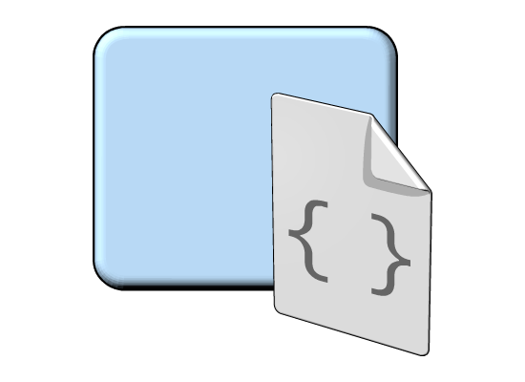



Creating Parameterized Stored Procedures
Parameterized stored procedures contain 3 major components:
Input parameters
Output parameters
Return values
Notes:
On this slide, you will learn parameterized stored procedures, input, output and return values. Mention that to define a stored procedure that accepts input parameters, you declare one or more variables as parameters in the CREATE PROCEDURE statement. Mention that to use an output parameter within Transact-SQL, you must specify the OUTPUT keyword in both the CREATE PROCEDURE and the EXECUTE statements. Also mention that the RETURN statement is most commonly used to return a status result or an error code from a procedure.
Input Parameter
Parameters are used to exchange data between stored procedures and functions and the application or tool that called the stored procedure or function:
Input parameters allow the caller to pass a data value to the stored procedure or function.
Output Parameters
Output parameters allow the stored procedure to pass a data value or a cursor variable back to the caller. User-defined functions cannot specify output parameters.
Return Values
Every stored procedure returns an integer return code to the caller. If the stored procedure does not explicitly set a value for the return code, the return code is 0.
References:
For more information about Parameterized Stored Procedures, see “Calling a Stored Procedure”, http://go.microsoft.com/fwlink/?LinkID=126188
For more information about using Parameterized Stored Procedures, see “Using Parameters in Stored Procedures and User-Defined Functions”, http://go.microsoft.com/fwlink/?LinkID=126189

Slide 13
Input Parameters
Provide appropriate default values
Validate incoming parameter values, including null checks
ALTER PROC Production.LongLeadProducts
@MinimumLength int = 1 -- default value
AS
IF (@MinimumLength < 0) -- validate
BEGIN
RAISERROR('Invalid lead time.', 14, 1)
RETURN
END
SELECT Name, ProductNumber, DaysToManufacture
FROM Production.Product
WHERE DaysToManufacture >= @MinimumLength
ORDER BY DaysToManufacture DESC, Name
EXEC Production.LongLeadProducts @MinimumLength=4

Slide 14
Output Parameters and Return Values
CREATE PROC HumanResources.AddDepartment
@Name nvarchar(50), @GroupName nvarchar(50),
@DeptID smallint OUTPUT
AS
INSERT INTO HumanResources.Department (Name, GroupName)
VALUES (@Name, @GroupName)
SET @DeptID = SCOPE_IDENTITY()
CREATE PROC HumanResources.AddDepartment
@Name nvarchar(50), @GroupName nvarchar(50),
@DeptID smallint OUTPUT
AS
IF ((@Name = '') OR (@GroupName = ''))
RETURN -1
INSERT INTO HumanResources.Department (Name, GroupName)
VALUES (@Name, @GroupName)
SET @DeptID = SCOPE_IDENTITY()
RETURN 0
DECLARE @dept int
EXEC AddDepartment 'Refunds', '', @dept OUTPUT
SELECT @dept
DECLARE @dept int, @result int
EXEC @result = AddDepartment 'Refunds', '', @dept OUTPUT
IF (@result = 0)
SELECT @deptID
ELSE
SELECT 'Error during insert'

Slide 15
Summary of Main Teaching Points
Stored procedures definition.
How to create and execute a simple stored procedures.
How to create and execute a parameterized stored procedures.
How to modify and remove existing stored procedures.

Slide 16
Question and Answer Session
Q & A

Slide 17
Next Lesson
Implementing Triggers

